Slide 1
Post-HF methods: Perturbation Theory, Coupled-clusters, Complete active space
Instructor: Prof. Tzuhsiung (Nick) Yang
Email: tyang@mx.nthu.edu.tw
Time: M5/6
Room: NTHU Library Comp Lab II
Notes:
Rafael Gomez

Slide 2
Suggested readings
Cremer, D. Møller–Plesset Perturbation Theory: From Small Molecule Methods to Methods for Thousands of Atoms. WIREs Computational Molecular Science 2011, 1 (4), 509–530.
(2) Bartlett, R. J.; Musiał, M. Coupled-Cluster Theory in Quantum Chemistry. Rev. Mod. Phys. 2007, 79 (1), 291–352.

Slide 3
Case study

Slide 4
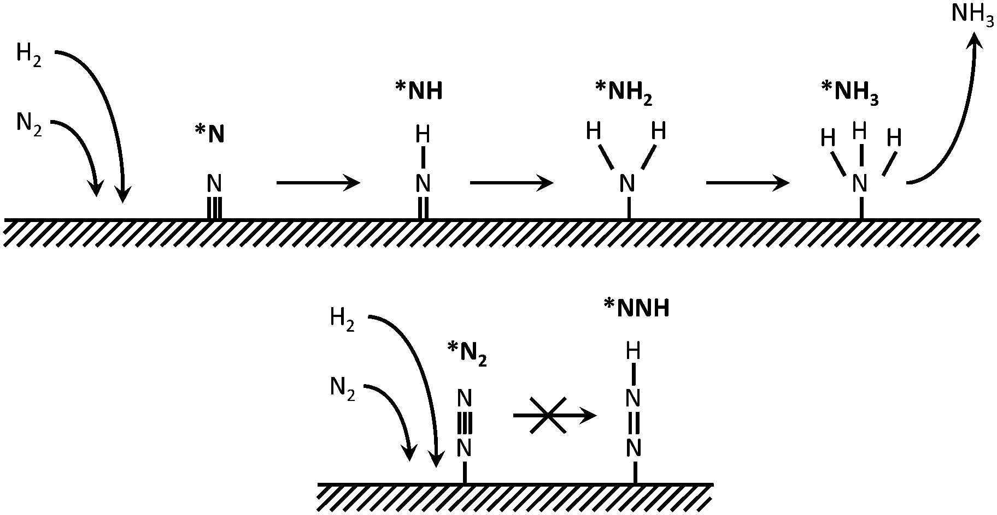
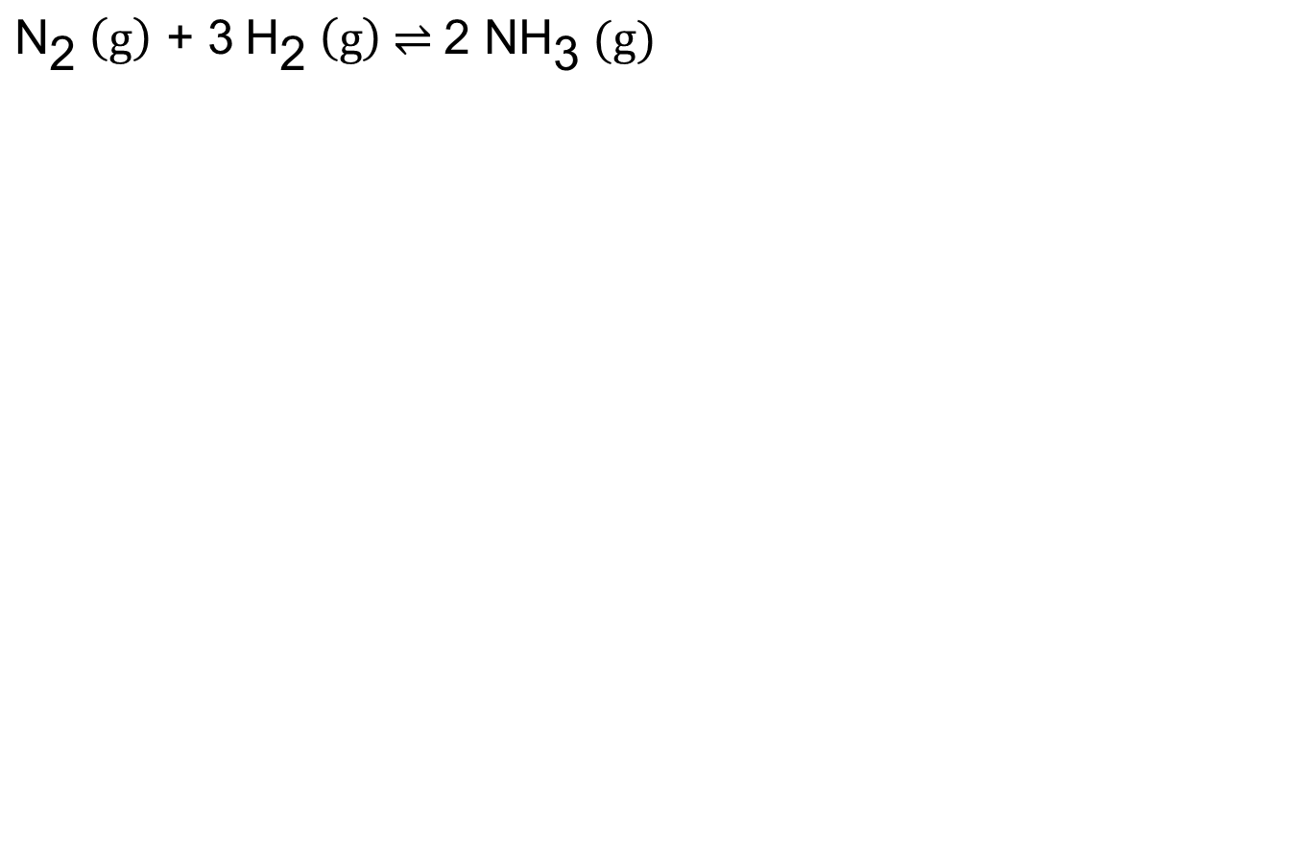
Haber-Bosch process
$${\text{N}}_{\text{2}} \left(\text{g}\right)\text{ + 3} {\text{H}}_{\text{2}} \left(\text{g}\right) \text{⇌} \text{2 }\text{N}{\text{H}}_{\text{3}}\text{ (}\text{g}\text{)}$$
Chem. Soc. Rev. 2014, 43, 5183

Slide 5
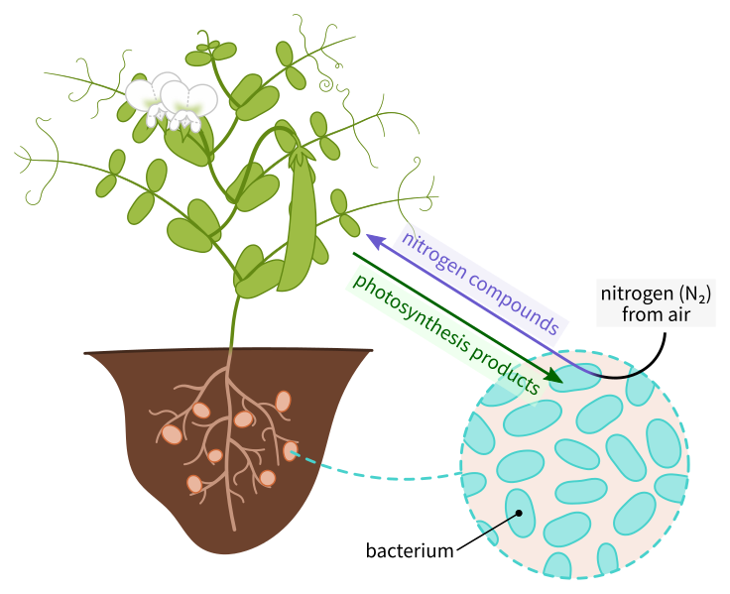
Nitrogen fixation
Symbiotic bacteria produces ammonia from atmospheric N₂ in exchange for the nutrients from their host plants

Slide 6
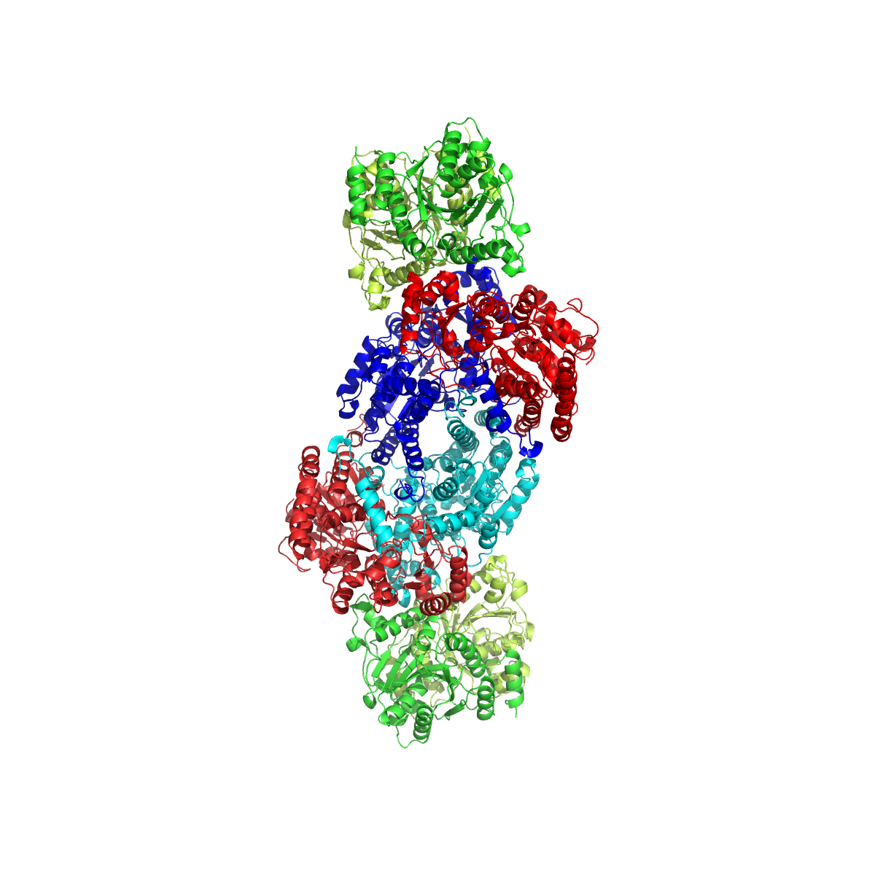
Nitrogenase
Nitrogenase

Slide 7
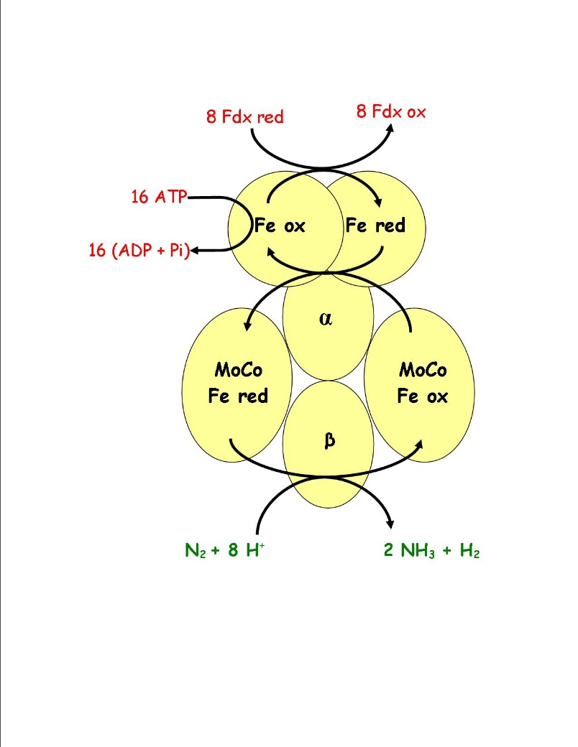
Nitrogenase
Nitrogenase

Slide 8
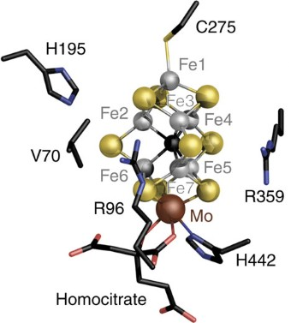
Nitrogenase
Nat. Commun. 2016, 7, 10902

Slide 9
Nitrogenase
Nat. Commun. 2016, 7, 10902

Slide 10
Nitrogenase
“C⁴⁻”
Science 2011, 334, 974

Slide 11
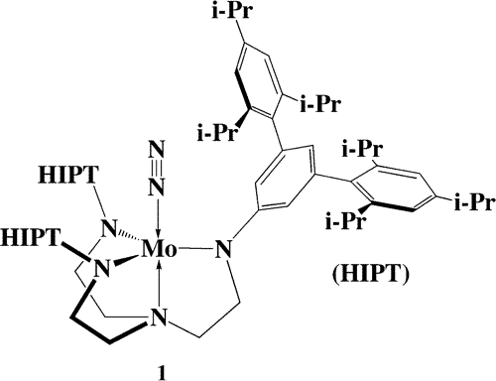
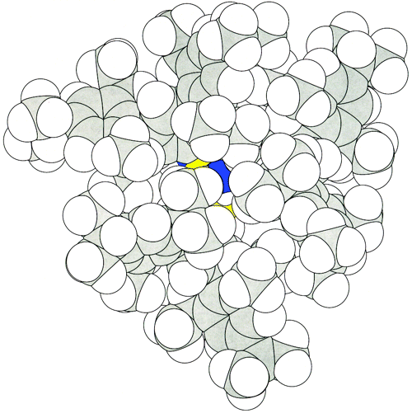
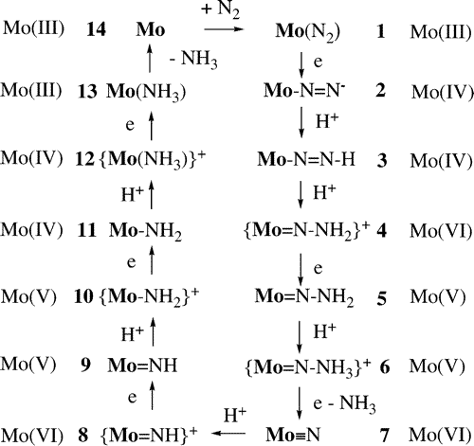
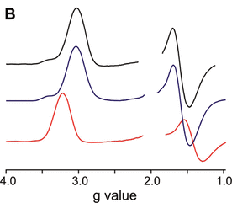
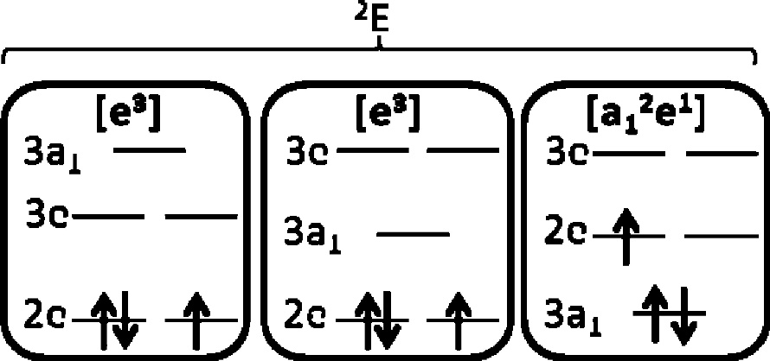
Model complex
(1) Schrock, R. R. Catalytic Reduction of Dinitrogen to Ammonia at a Single Molybdenum Center. Acc. Chem. Res. 2005, 38 (12), 955–962.
(2) Yandulov, D. V.; Schrock, R. R. Catalytic Reduction of Dinitrogen to Ammonia at a Single Molybdenum Center. Science 2003, 301 (5629), 76–78. (3) McNaughton, R. L.; Roemelt, M.; Chin, J. M.; Schrock, R. R.; Neese, F.; Hoffman, B. M. Experimental and Theoretical EPR Study of Jahn−Teller-Active [HIPTN3N]MoL Complexes (L = N2, CO, NH3). J. Am. Chem. Soc. 2010, 132 (25), 8645–8656.

Slide 12
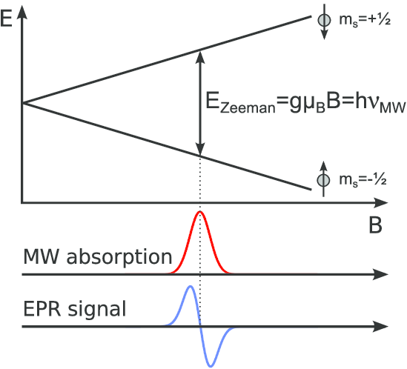
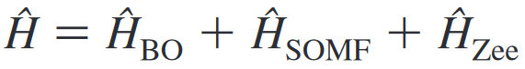
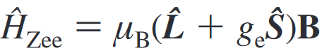
Zeeman splitting
Spinning charges (e.g. electron precession) generate local magnetic field, which interacts with external magnetic field.

Slide 13
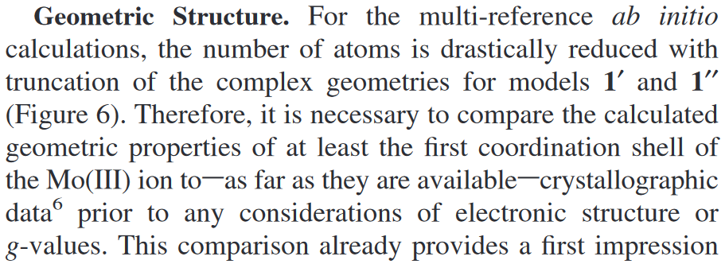
Interactive

Slide 14
Molecular visualizers
Molecular visualizers: Graphic user interfaces that allow you to visualize molecules by their coordinates
Avogadro
Jmol
Mercury
PyMOL
UCSF Chimera
Vesta
VMD

Slide 15
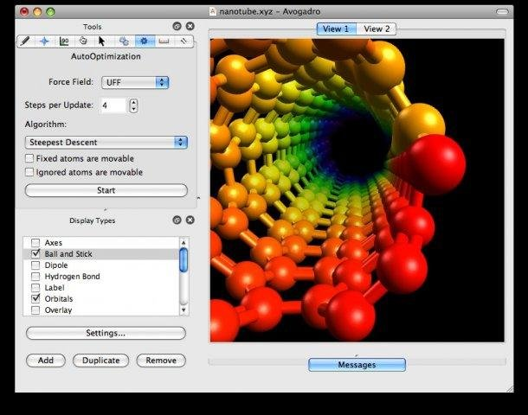

Avogadro
Avogadro is a molecular editor and visualizer with limited support for force field optimization. It is written as a GUI for the backend openbabel
Cross platform
Multiple language support

Slide 16

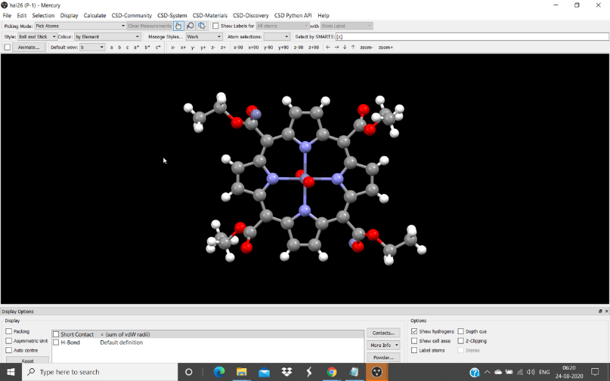

Mercury
Mercury is a molecular visualizer developed by the Cambridge Crystallographic Data Centre (CCDC)
It can be downloaded as a stand-alone software or as a part of the licensed CCDC software suite
It is specially designed to handle crystal structures
It has limited molecular building functionality

Slide 17
Interactive
Obtain the crystallographic information file (cif) for Mo-NH₃ complex from ref 6 of the paper using webcsd.
Remove the bulky R groups on the amide side arms, solvent molecules, and disorders from the cif file using Avogadro (tips: 1) under drawing mode, right click on bonds will replace the bonds with hydrogen caps; 2) under click mode, double click on an atom of a molecule will select the whole molecule; 3) click delete on your keyword will delete the selected atom(s))
Go to build > Cartesian Builder and copy the coordinates of the modified molecule (30 atoms).

Slide 18
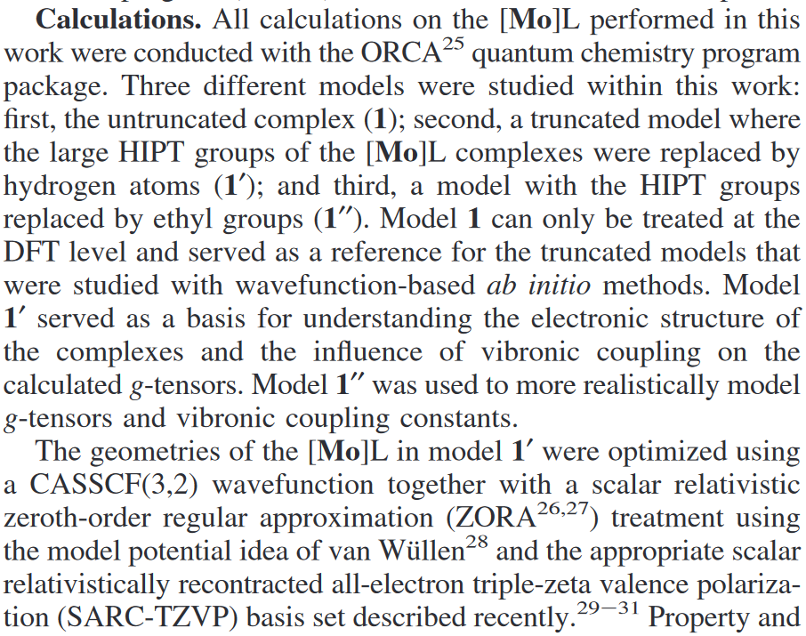
Interactive

Slide 19
Interactive
Paste the coordinates to “Mo-TAEA-NH3.xyz” in Exercise1.
Submit the optimization job.
Read the input file. What do you see that is different from those before?

Slide 20
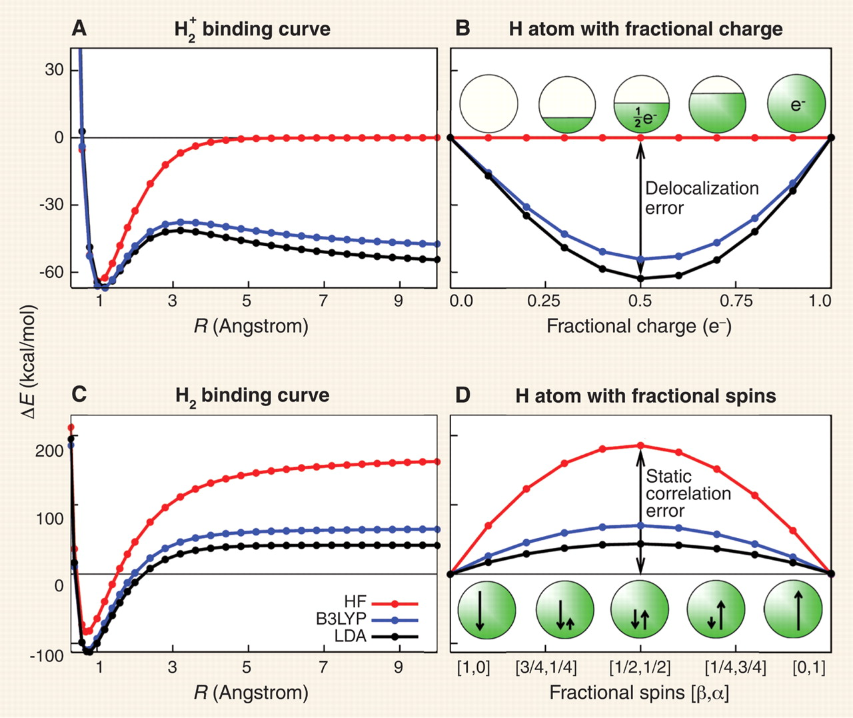
Errors in DFT
Cohen, A. J.; Mori-Sánchez, P.; Yang, W. Insights into Current Limitations of Density Functional Theory. Science 2008, 321 (5890), 792–794.

Slide 21
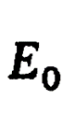
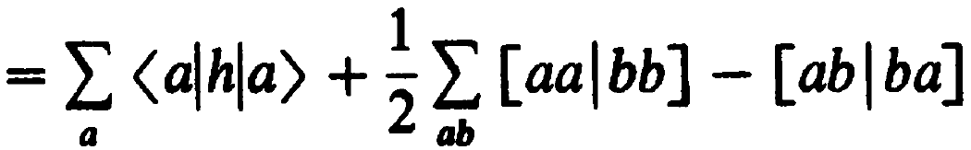
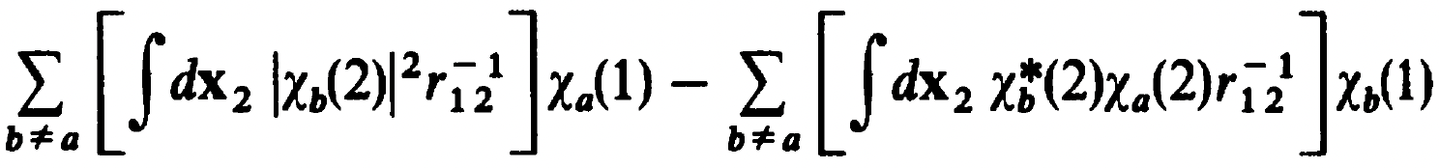
Fock operator
In order for the Hamiltonian to act on N-electrons within a mean-field, the two-electron integrals are replaced with mean-field integrals (operators).
$$⇒$$
$$⇒$$
The first term ${\hat{J}}_{b}\left(1\right)$ is a local operator that describes the total averaged potential acting on $χ_{a}(1)$.
The second term ${\hat{K}}_{b}\left(1\right)$ is a non-local operator that describes the total averaged potential, formed by other electrons if they were smeared in the space of $χ_{b}^{∗}χ_{a}$, acting on electron one if it was in spin orbital $χ_{b}$.

Slide 22
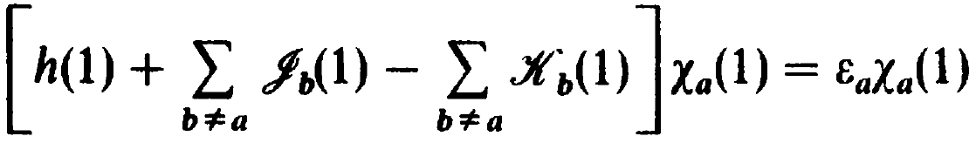
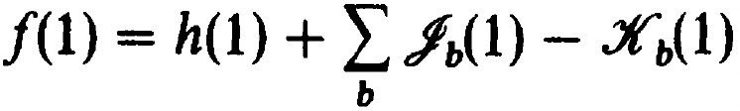
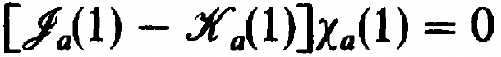
Fock operator
With the mean-field approximation, we can write down the (pseudo)eigenvalue problem which gives orbital energies
The operator (Fock operator) can be further written as
because
This last equation that the coulomb and exchange interactions cancel each other out exactly at the one-electron limit may seem trivial. However, it is a very important physical constraint and it is one of the main errors in density functional theory (DFT) called self-interaction error.

Slide 23
Interactive
UHF
J_{11,a} is 0.77 Eh
K_{11,a} is 0.77 Eh
Self-interaction error is J_{11,a} - K_{11,a} = 0.000 Eh
UKS(PBE)
J_{11,a} is 0.3873 Eh
E_{xc} is -0.3851 Eh
Self-interaction error is J - E_{xc} = 0.0022 Eh

Slide 24
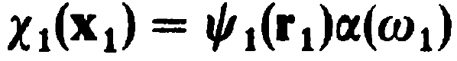
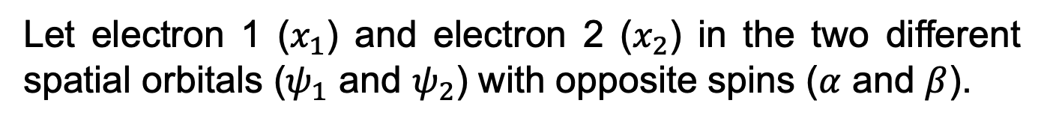
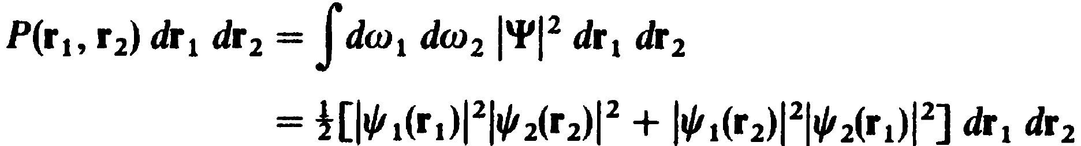
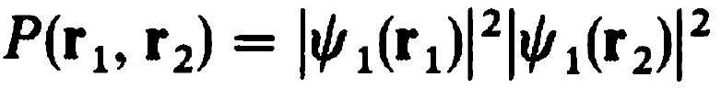
Slater determinants
Slater determinants still have the issue
Electrons with opposite spins are still not correlated
Let electron 1 ($x_{1}$) and electron 2 ($x_{2}$) in the two different spatial orbitals ($ψ_{1}$ and $ψ_{2}$) with opposite spins ($α$ and $β$).
,
The probability is
Cross terms vanish as $\left\langle α(w_{i}) | β(w_{i})\right\rangle =0$
Let $ψ_{1}=ψ_{2}$
$⇒$ there is finite probability of finding two electrons in the same spot, which is not physical, due to the lack of electron correlations for opposite spins.

Slide 25
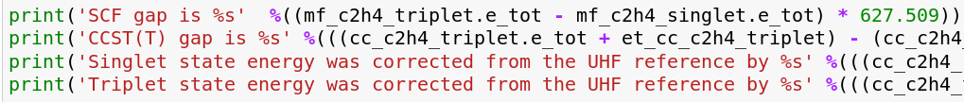
Interactive
SCF gap is 76.36
CCST(T) gap is 104.14
Singlet state energy was corrected from the UHF reference by -201.03
Triplet state energy was corrected from the UHF reference by -173.25

Slide 26
Errors in DFT
Cohen, A. J.; Mori-Sánchez, P.; Yang, W. Insights into Current Limitations of Density Functional Theory. Science 2008, 321 (5890), 792–794.

Slide 27
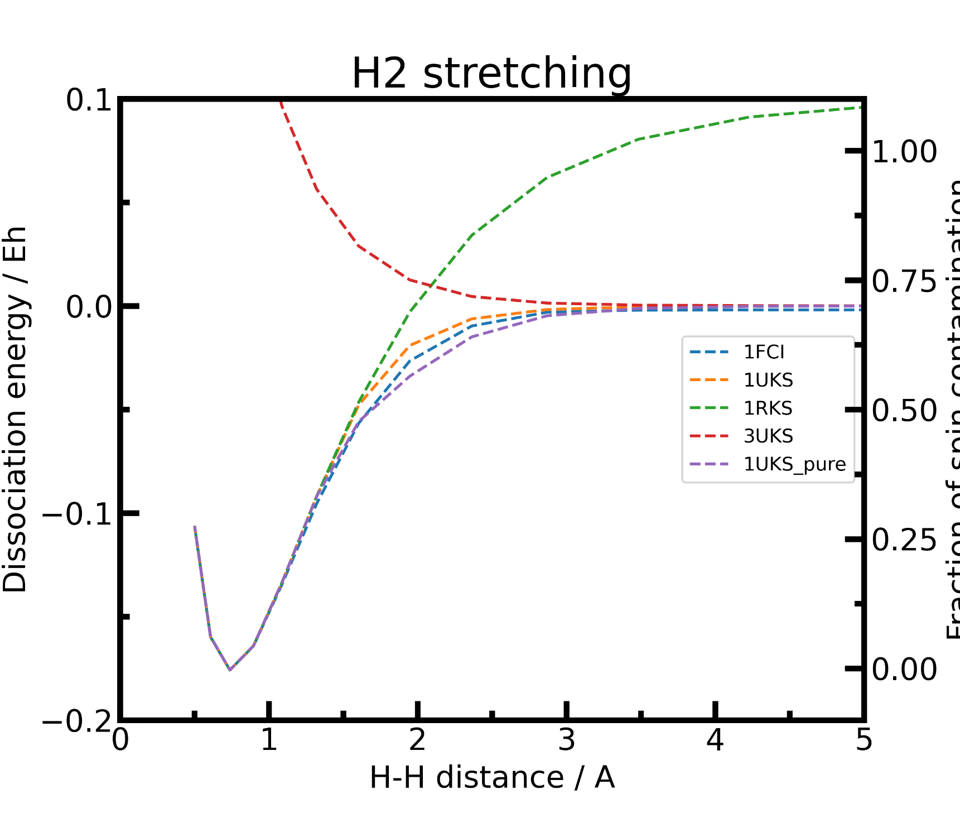

Slide 28
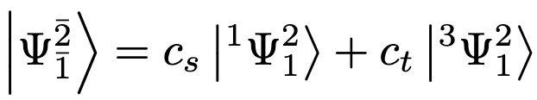
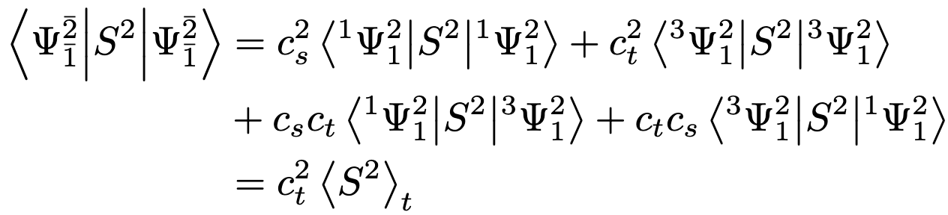
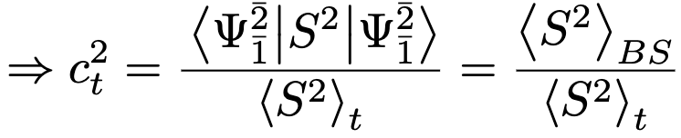
Broken symmetry state
The single determinant broken symmetry (BS) state can be written as a linear combination of the two SACs
The S² expectation value of the BS wavefunction is
Yamaguchi, K.; Jensen, F.; Dorigo, A.; Houk, K. N. A Spin Correction Procedure for Unrestricted Hartree-Fock and Møller-Plesset Wavefunctions for Singlet Diradicals and Polyradicals. Chemical Physics Letters 1988, 149 (5), 537–542.

Slide 29
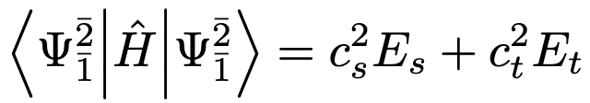
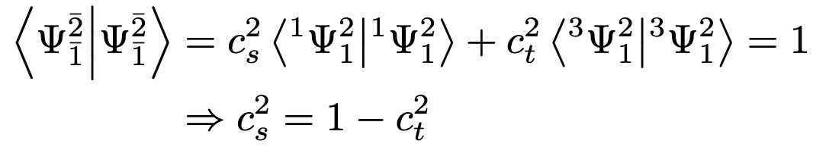
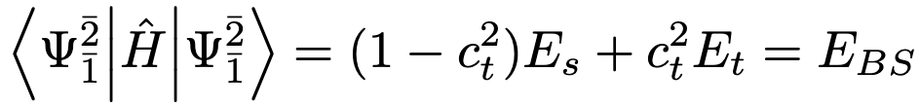
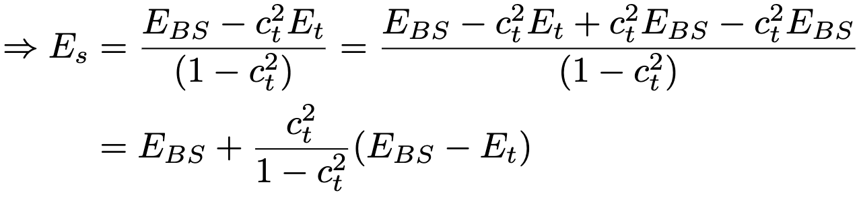
Broken symmetry state
The energy of the BS state
By orthonormality relation,
Hence, the energy of the BS and pure state
Yamaguchi, K.; Jensen, F.; Dorigo, A.; Houk, K. N. A Spin Correction Procedure for Unrestricted Hartree-Fock and Møller-Plesset Wavefunctions for Singlet Diradicals and Polyradicals. Chemical Physics Letters 1988, 149 (5), 537–542.

Slide 30
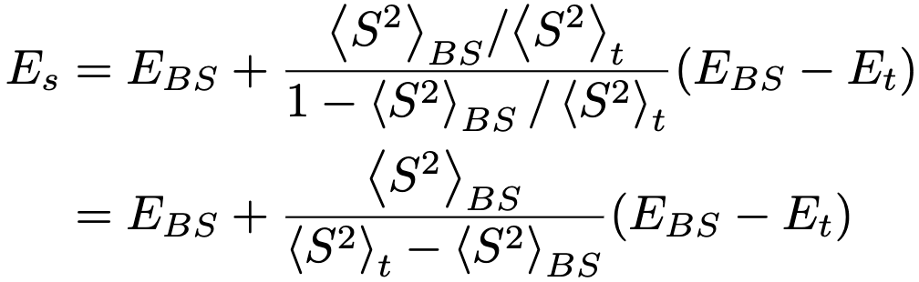
Spin purification
Substitute $c_{t}^{2}$ by the S² expectation values
$E_{t}$ can be obtained from any of the triplet wavefunctions
This process of correcting the energy of the BS state using the S² value of the BS and triplet states and the energy of the triplet state is called spin purification.
Yamaguchi, K.; Jensen, F.; Dorigo, A.; Houk, K. N. A Spin Correction Procedure for Unrestricted Hartree-Fock and Møller-Plesset Wavefunctions for Singlet Diradicals and Polyradicals. Chemical Physics Letters 1988, 149 (5), 537–542.

Slide 31
Interactive

Slide 32
DFA vs HF
DFA:
Black box approximate functionals that may or may not be constrained to physics-based asymptotic limits.
Some have issues with SIE.
Have issues with static correlation.
HF
Formally exact within the mean field approximation.
No issue with one particle SIE.
Have issues with static correlation.
Have issues with dynamics correlation.

Slide 33
Post HF method
Given the advantages of HF theory, it is tempting to improve upon HF wavefunction. There are several ways to achieve such improvements:
For dynamic correlation:
Perturbation theory (PT).
Some examples are second order (MP2), third order (MP3), and fourth order (MP4) PT with their corresponding scaling N⁵, N⁶, and N⁷, respectively.
Coupled cluster (CC) theory
Some examples are CC singles and doubles (CCSD), and CCSD and triplets (CCSDT), and CCSD with perturbative triples (CCSD(T)) with their corresponding scaling N⁶, N⁸, and N⁷, respectively.

Slide 34
Post HF method
For static correlation:
Complete active space SCF (CASSCF), which scales as M*N⁴ where M is the number of configurations.
For both correlations:
CASPT2, which scales as M*N⁵.
N-electron valence second order perturbation theory (NEVPT2), which scales as M*N⁵.
Density matrix renormalization group (DMRG) CASSCF.

Slide 35
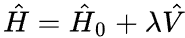
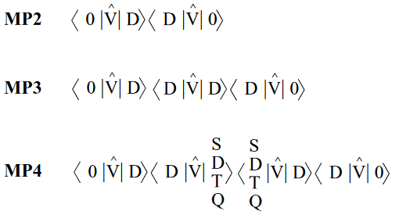
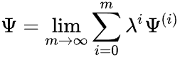
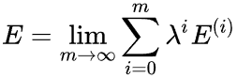
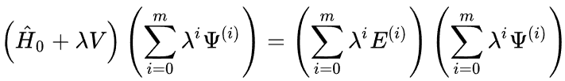
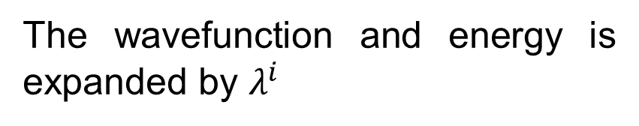
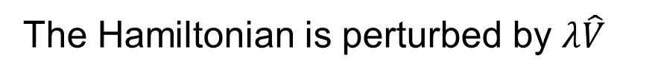
MP theory
Moller Plesset (MP), or many body (MB), perturbation theory is commonly employed post-HF method to treat dynamic correlation (the probability of finding two electrons in the same spot for opposite spins).
The Hamiltonian is perturbed by $λ\hat{V}$
The wavefunction and energy is expanded by $λ^{i}$
,
The Schrodinger equation is then

Slide 36
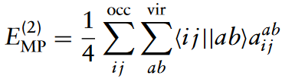
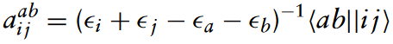
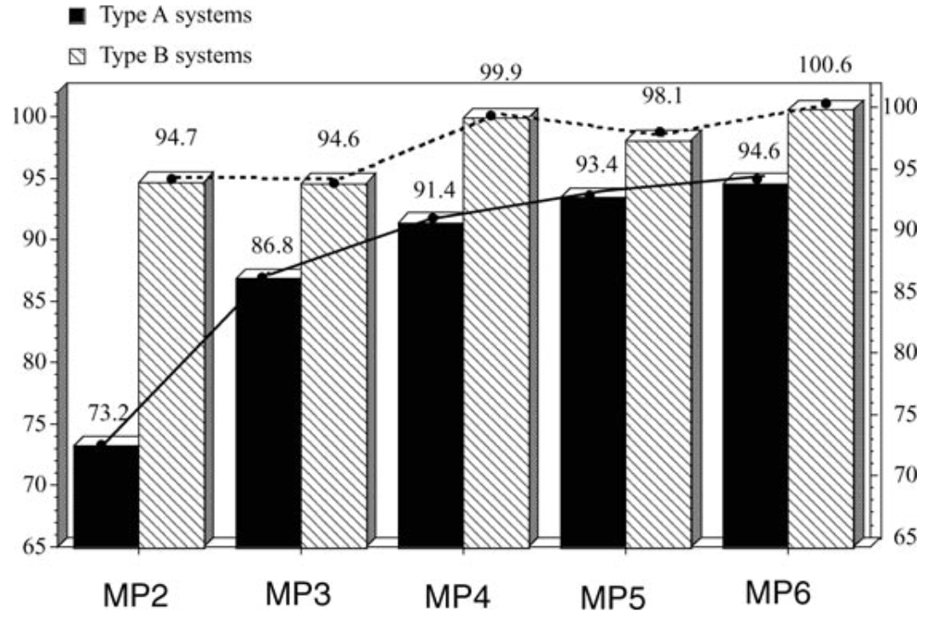
MP theory
At the second order, MP2, the correct has the form
,
Slow convergence of correlation energy

Slide 37
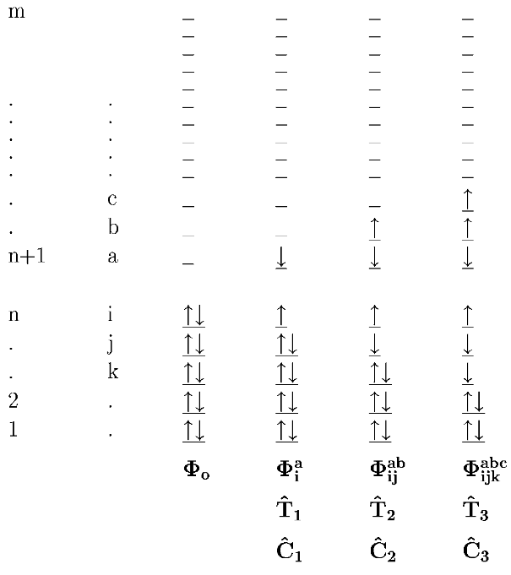



CC theory
Coupled cluster (CC) theory is commonly considered the best method among post-HF methods to treat dynamic correlation (the probability of finding two electrons in the same spot for opposite spins).
The CC wavefunction is
where the exponential of the excitation operator $\hat{T}$ can expressed using Taylor series expansion
and the excitation operator includes all orders of excitations

Slide 38


CCSD and CCSD(T)
Coupled clusters singles and doubles with perturbative triplets (CCSD(T)) is considered the golden standard of wavefunction theory (WFT) for quantum chemistry except for strongly correlated systems. At infinite order, MBPT and CC converge to the same expression.
Its performance is shown below
Reaction enthalpy

Slide 39




CASSCF
Complete active space self-consistent field (CASSCF) method is one of the most commonly used post-HF method to treat multiconfiguration wavefunctions and explicitly treat static correlation.
The CAS wavefunction is
Each $\left|\left.μ\right\rangle \right.$ is called a configuration state function (CSF). The coefficients $C_{μ}^{\left(0\right)}$ are determined self consistently.
For a given N number of electrons, n number of active orbitals, and a total spin of S. There are N_{cas} CSFs.

Slide 40

Final caveat
Dans, P. D.; Walther, J.; Gómez, H.; Orozco, M. Multiscale Simulation of DNA. Current Opinion in Structural Biology 2016, 37, 29–45.

